Slide 1
TAKENMIND GLOBAL DATA ANALYTICS INTERNSHIP
PROOF OF CONCEPT PROJECT
NAME : KOLLI SATYA SAI SANDEEP
COUNTRY : INDIA
LinkedIn : https://www.linkedin.com/in/sai-sandeep-kolli-8a9556201
EMAIL :kollisatyasaisandeep@gmail.com
PROJECT TITLE ; ATTRITION CONTROL

Slide 2
SOLUTION METHODOLOGY
In other to proffer solution to the challenges faced by the company using data analytics to derive insights from the data available, the following techniques were adopted
STEP 1: UNIVARIANT ANALYSIS
Analysis of individual information of Employees that left
Analysis of individual information of Existing Employees
The display out of both visuals are compared to draw out patterns and insights

Slide 3
STEP 2: BI/Multi VARIANT ANALYSIS
Analysis of 2 or more of information of Employees that left to discover hidden correlation
Analysis of 2 or more of information of Existing Employees to discover hidden correlation
The display out of both visuals are compared to draw out patterns and insights
STEP 3: Actionable Insights, Observations and Recommendations
The outputs of Step 1 and 2 brings about hidden discoveries in the form of observations and
recommendations that can be adopted or information that need to be paid attention to so as
to help solve the company’s challenge

Slide 4
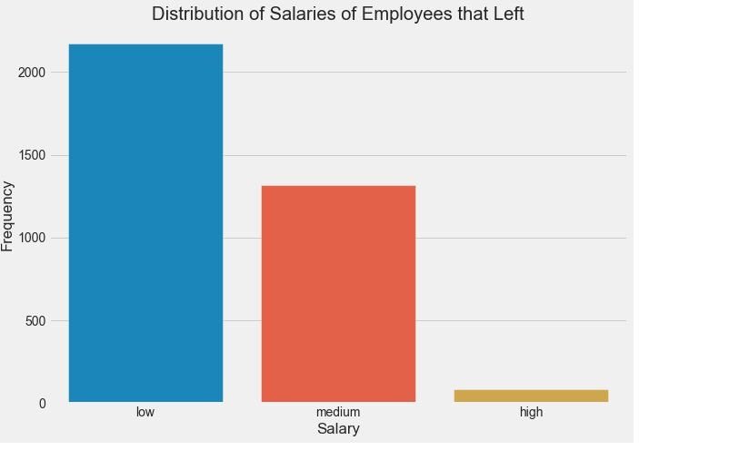
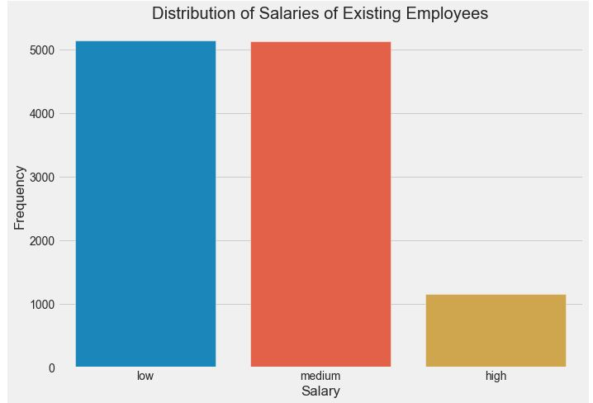
Visualization of Methodology
Step 1 : UNIVARIANT ANALYSIS
This stage involve analyzing each features of the data
CHART 1

Slide 5
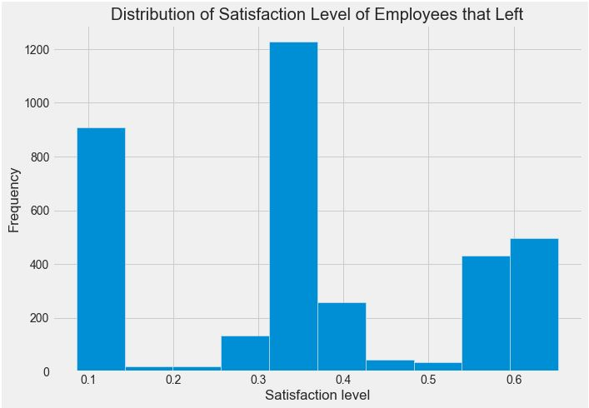
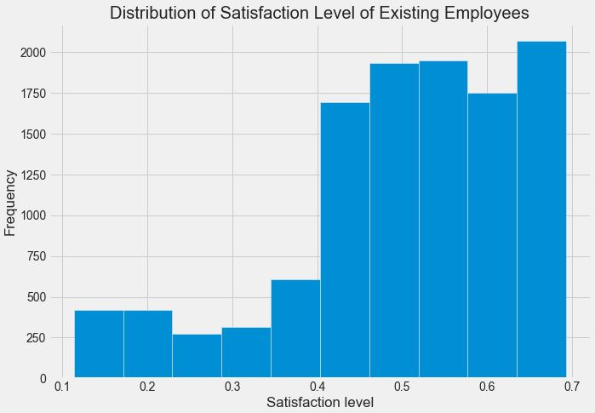
Univariant Analysis Cont’d
CHART 2

Slide 6
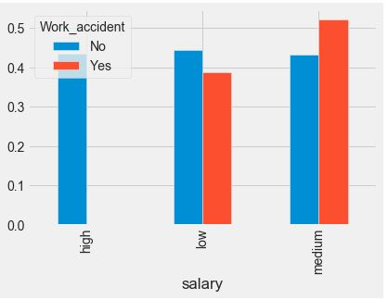
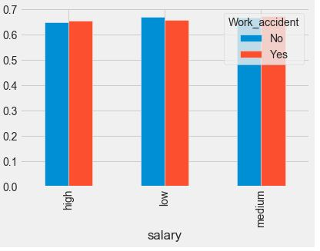
Step 2 : BIVARIANT ANALYSIS
This stage involve analyzing different features of the data the evaluate how correlated they are
CHART 3
Satisfaction Level of Employees that left
base on Work accident Salary Compensation"
Satisfaction Level of Existing Employees
base on Work accident Salary Compensation"

Slide 7
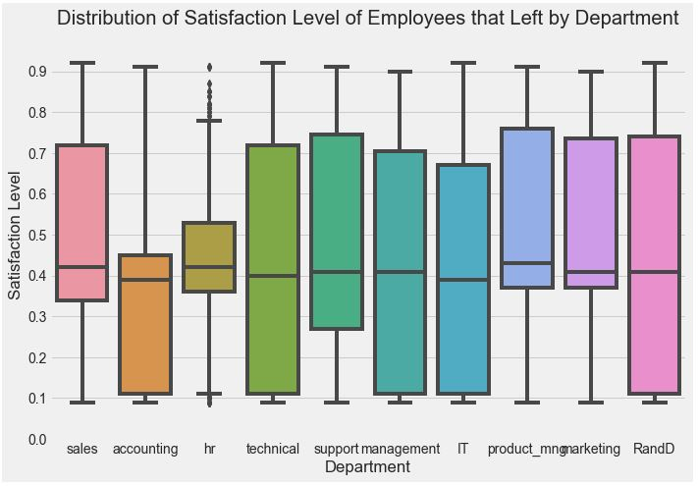
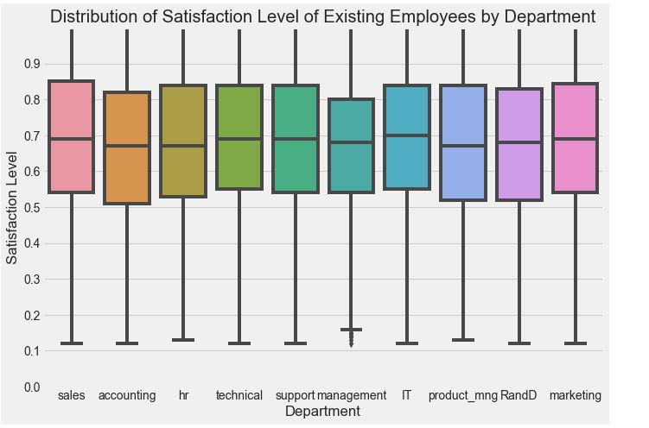
Bivariant Analysis Cont’d
CHART 4
Satisfaction Level of Employees that left
Satisfaction Level of Existing Employees
Satisfaction Level of Employees that left

Slide 8
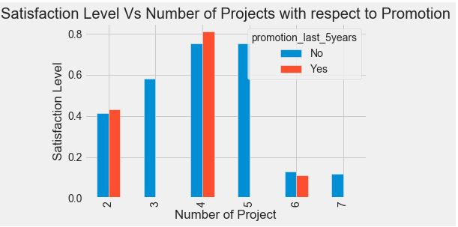
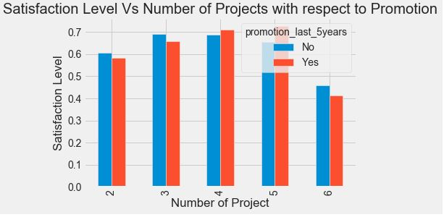
Multi-Variant Analysis
CHART 5
Satisfaction Level of Employees that left base on the
Number of Projects and Promotion
Satisfaction Level of Existing Employees base on the
Number of Projects and Promotion

Slide 9
STEP 3: Actionable Insights, Observations and Recommendations
After exploring the data of the Employees that are existing and those that left simultaneously, the following insights and observations were discovered;
1. From chat 2, the mean satisfaction level of employees that left was around 40% while those existing was around 70%. After further analysis, it was discovered that 65% of employees that left had less than 45% satisfaction level. A further dive into checking this employees with 45% satisfaction level who had left, it was further discovered that 99.6% of them didn’t receive promotion in the last 5 years.
The insights from employees that left provides a line of thought of checking Existing employees with the same satisfaction level of 45% and it was discovered that 13.8% of Existing employees are in this range of which 97.7% of them hasn’t been promoted within the last 5 years making them prone to leave.
Recommendation
To control attrition, these employees need to be identified and compensated one way or the other so as to increase their satisfaction level and loyalty to the company

Slide 10
Cont’d
2. From chat 3, it was discovered that the salary structure of those that left who had work accident was within the Low and medium range which when analyzed from satisfaction level point their satisfaction level was approximately 50%. However, checking this information with those still in the company it was discovered that their salary was distributed into low, medium and high range which further improved satisfaction level.
This let us see that the company maintained a good salary structure for those that had work accidents.
Recommendation
To control attrition, the company the need to maintain this salary structure or improve it more as this will improve employees satisfaction because they are well compensated

Slide 11
Cont’d
6. From chat 5, it was discovered that as the Number of Projects of employees who left increased greater than 4 , it results to a decline in their Satisfaction level.
Recommendation
In other to prevent future attrition and constantly maintain a high satisfaction level of employees, the company should ensure the number of projects allocated to an employee is not too overwhelming thereby losing enthusiasm which may result to seeing a need to leave

Slide 12
It was great working with you and I have learnt lot of concepts and gained knowledge
Thank you Takenmind Technologies

